Slide 1
Password-Protected
Parking System Controller
VHDL Implementation on Nexys A7-100T FPGA
TEAM
Zulkar Nain Sayeed
Jaleel Ur Rehman
MD Arman Zaid Efty
Muhammad Umar Hayat
Hardware Engineering Lab • HSHL • SS 2026
Notes:
Good morning everyone. My name is [name], and I'm presenting on behalf of our team — Muhammad Umar Hayat, Jaleel Ur Rehman, Efty, and Zulkar Nain Sayeed. Today we're presenting our Hardware Engineering Lab project for SS 2026: a Password-Protected Parking System Controller, implemented in VHDL and tested on the Digilent Nexys A7-100T FPGA board.

Slide 2
What Is It?
A digital parking lot controller implemented entirely in VHDL on an FPGA - no microcontroller, just programmable logic.
Access Control
Occupancy Tracking
Status Feedback
Vehicles can only enter after supplying a correct 4-bit password via on-board switches. Wrong code → blocked.
Maintains a real-time count of occupied vs. available spaces (max 15). Entry is blocked when the lot is full.
Free spaces shown on 7-segment display. LEDs indicate: space available, lot full, password accepted/rejected.
Notes:
So what exactly did we build? It's a fully digital parking lot controller — no microcontroller, no software, just programmable logic on an FPGA. The system does three things: it controls vehicle access using a 4-bit password entered via on-board switches — wrong code means entry is blocked. It tracks occupancy in real time with a maximum capacity of 15 spaces and automatically prevents new entries when the lot is full. And it gives continuous status feedback through LEDs and a seven-segment display.

Slide 3
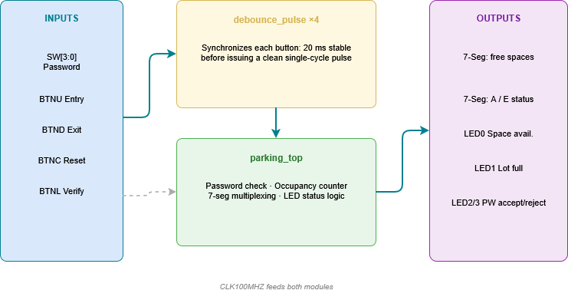
System Architecture
Two VHDL entities work together, a reusable debounce module and the top-level controller.
Notes:
This slide shows the overall architecture of our parking system. The design is divided into two VHDL entities: the debounce_pulse module and the parking_top module.
On the left are the system inputs. The four push buttons are first connected to the debounce module. Mechanical buttons don't produce a clean signal when pressed—they generate multiple rapid transitions, known as button bounce. The debounce module removes these unwanted transitions and generates a single clean pulse for each button press.
The four password switches are connected directly to the parking_top module because switches remain stable and don't require debouncing.
The parking_top module is the main controller. It verifies the password, updates the parking occupancy counter, controls the LEDs, and drives the seven-segment display. Both modules operate using the same 100 MHz FPGA clock, allowing all logic to remain synchronized

Slide 4
VHDL Code - Key Concepts
Three core logic blocks explained with annotations
① Password Check
② Entry / Exit Counter
constant AUTHORIZED_CODE :
STD_LOGIC_VECTOR(3 downto 0) := "1010";
elsif verify_p = '1' then
if SW = AUTHORIZED_CODE then
pw_ok <= '1'; -- grant access
else
pw_ok <= '0'; -- block entry
end if;
if entry_p='1' and pw_ok='1'
and occupied < 15 then
occupied <= occupied + 1;
elsif exit_p='1'
and occupied > 0 then
occupied <= occupied - 1;
end if;
💡 The 4-bit switch vector SW[3:0] is compared directly against the hardcoded constant "1010". On BTNL press, pw_ok is set high or low in one clock cycle.
💡 Entry needs pw_ok='1' AND occupied<15. Exit saturates at 0, never underflows. Max: 15 spaces.
③ Debounce Entity
entity debounce_pulse is
generic ( STABLE_COUNT : natural := 2000000 ); -- 20 ms at 100 MHz
Port ( clk : in STD_LOGIC; btn_in : in STD_LOGIC; pulse : out STD_LOGIC );
end debounce_pulse;
-- Instantiated ×4: one per button (BTNU, BTND, BTNC, BTNL)
Notes:
This slide highlights the three most important parts of our VHDL implementation.
The first block is the password verification. We define the authorized 4-bit password as 1010. Whenever the Verify button is pressed, the FPGA compares the switch inputs with this stored value. If they match, the signal pw_ok becomes high and access is granted. Otherwise, access is denied.
The second block is the entry and exit counter. A vehicle is allowed to enter only when the password is correct and the parking lot is not full. In that case, the occupied count increases by one. For exiting, no password is required. The counter decreases, but it never goes below zero, preventing underflow.
Finally, the third block shows the debounce entity. It waits until a button input remains stable for approximately 20 milliseconds, which corresponds to 2 million clock cycles at 100 MHz. This ensures that every physical button press generates only one clean pulse and prevents false counts

Slide 5
How Entry Works
Step-by-step flow a vehicle follows to enter the parking lot:
1
Set Password
2
Press BTNL (Verify)
User sets SW[3:0] to the 4-bit code.
Authorized code: SW3=1, SW2=0, SW1=1, SW0=0 (1010)
Controller compares switch vector against the stored constant. Match → display shows A (Accepted).
No match → display shows E (Error).
3
Press BTNU (Entry)
4
Press BTND (Exit)
Only if password was accepted AND lot is not full: occupancy counter increments by 1. Available spaces on display decreases.
Any vehicle may exit freely. Counter decrements, saturating at 0. No password needed for exit.
Notes:
The entry flow has four steps. First, the user sets switches SW3 to SW0 to the access code — that's 1, 0, 1, 0 in binary. Second, they press BTNL to verify. The controller compares the switch state against the stored constant. A match shows the letter A on the display for Accepted; no match shows E for Error and blocks further entry. Third, if accepted and the lot is not full, pressing BTNU increments the counter and the available spaces on the display decreases by one. Fourth, any vehicle can exit freely by pressing BTND — the counter decrements with no password required.

Slide 6
Outputs at a Glance
Seven-Segment Display
LED Status Indicators
AN7 (leftmost)
LED0
Space available
A → Password accepted
AN7 (leftmost)
LED1
Parking full
E → Wrong password
AN1 (middle)
LED2
Password accepted
Tens digit of free spaces
AN0 (rightmost)
LED3
Password rejected
Ones digit of free spaces
LED[15:4] are unused and held low
Notes:
The system communicates through two output channels. The seven-segment display uses three digit positions: the leftmost digit shows A when the password was accepted or E when rejected. The middle and rightmost digits show the two-digit count of free spaces. On the LED side: LED0 lights when at least one space is free, LED1 when the lot is completely full, LED2 confirms a correct password, and LED3 signals a wrong one. The remaining LEDs from 4 to 15 are unused and held low

Slide 7
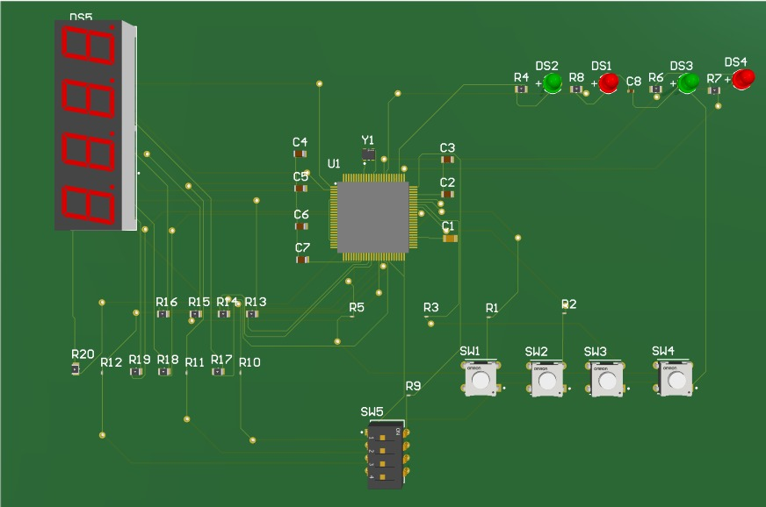
PCB Layout - Altium Designer
Component Map
U1
FPGA - MachXO2-640HC
DS5
4-digit 7-Seg display
SW1–SW4
Tactile push buttons
SW5
4-pos DIP switch (PW)
C1–C7
Decoupling capacitors
R1–R20
Current-limit resistors
DS1–DS4
Status LEDs (R/G)
Y1 Oscillator
Designed in Altium Designer
Notes:
This is our custom PCB concept designed in Altium Designer. The goal was to take everything on the Nexys development board and reduce it to only what our parking system actually needs. At the center is U1 — the Lattice MachXO2-640HC FPGA. The large black component at the top is DS5, our 4-digit seven-segment display. Bottom left shows SW5, the 4-position DIP switch used for password input, and SW1 through SW4 are the tactile push buttons for entry, exit, reset, and verify. The resistors R1 through R20 handle current limiting for the LEDs and display segments, and C1 through C7 are the decoupling capacitors placed close to the FPGA power pins.

Slide 8
Bill of Materials (BOM)
Components for the custom PCB — pricing from Altium Designer / supplier quotes.
#
Designator
Description
Manufacturer
Part Number
Qty
Supplier
Unit €
Total €
1
C1
Chip Cap 100nF 50V
TDK
C2012X5R1E106K085AC
1
Arrow
0.20
0.20
2
C2-C7
Chip Cap 100nF 50V
KYOCERA AVX
0402ZD104KAT4A
6
Newark
0.003
0.02
3
DS1, DS4
Red LED 0805
Würth
150080RS75000
2
Mouser
0.16
0.32
4
DS2, DS3
Green LED 0805
Würth
150080GS75000
2
Mouser
0.16
0.32
5
DS5
LED 7-Seg 4-digit
Lite-On
LTC-4627G
1
Mouser
3.24
3.24
6
R1–R3
Res 10 kΩ 0402
TE Connectivity
CRG0201F10K
8
Mouser
0.16
1.28
7
R4,R6,R7…
Res 330 Ω 0805
Vishay
CRCW0805330RJNEA
12
Mouser
0.09
1.08
8
SW1–SW4
Switch Tactile SPST
Omron
B3W-1000
4
RS
0.90
3.60
9
SW5
Switch DIP 4-pos
Omron
A6D-4100
1
Arrow
2.32
2.32
10
U1
FPGA MachXO2-640HC
Lattice Semico.
LCMXO2-640HC-4TG100C
1
Mouser
8.34
8.34
11
Y1
Crystal Oscillator
Abracon
ABM8-12.000MHZ-B2-T
1
Mouser
0.38
0.38
Total excl. FPGA
≈ 12.76 €
Total incl. FPGA
≈ 21.10 €
Notes:
Here is the complete bill of materials for the custom PCB. All prices have been verified directly from supplier websites — Arrow, Newark, Mouser, and RS. The total cost excluding the FPGA comes to approximately 12.38 euros. Including the FPGA at 8.34 euros from Mouser, the full board cost is approximately 20.72 euros. One important note — the Lattice MachXO2-640HC currently has a 53-week factory lead time and is on backorder, so early ordering would be necessary for any physical production.

Slide 9
Verification & Summary
VHDL Testbench
Key Facts
1
Simulated reset, correct/wrong password, entry/exit sequencing, and full-lot saturation.
▸ Max capacity: 15 spaces
▸ Password: 4-bit (SW[3:0] = 1010)
Synthesis & Implementation
2
▸ Debounce: 20 ms per button
Synthesized in Vivado targeting the Nexys A7-100T XDC constraints.
▸ Clock: 100 MHz (E3 pin)
▸ Display: 3-digit 7-segment
Hardware Validation
3
▸ FPGA: Artix-7 XC7A100T
Bitstream loaded onto the physical FPGA board; button, switch, LED, and 7-seg behavior verified.
▸ PCB tool: Altium Designer
Notes:
To verify the design we followed a three-step flow. First, a VHDL testbench simulated all key scenarios — reset, correct and wrong passwords, sequential entry and exit, and the full-lot boundary. Second, the design was synthesized and implemented in Vivado with the Nexys A7-100T XDC pin constraints. Third, the bitstream was loaded onto the physical board and all functions were confirmed in hardware. To summarize the key figures: 15-space capacity, 4-bit password 1010, 20 millisecond debounce, 100 MHz clock, 3-digit seven-segment display, Artix-7 FPGA on the prototype board, and Altium Designer for the PCB. Thank you — we're happy to take any questions.

Slide 10
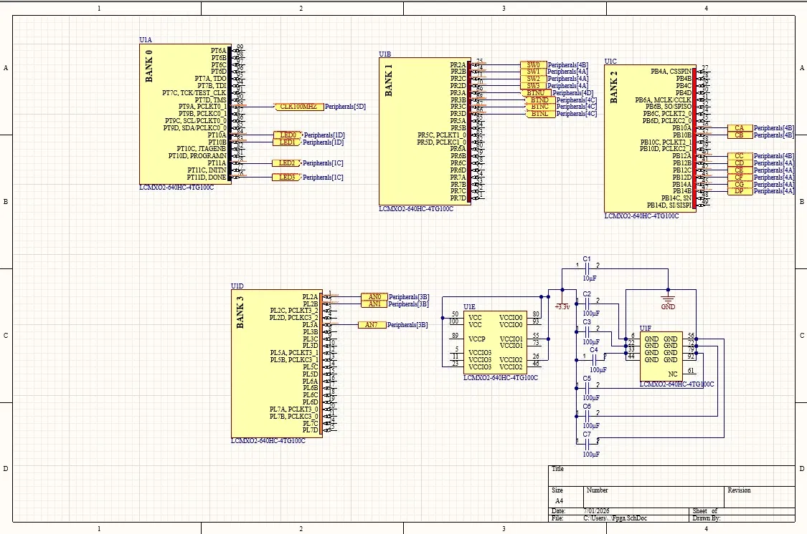
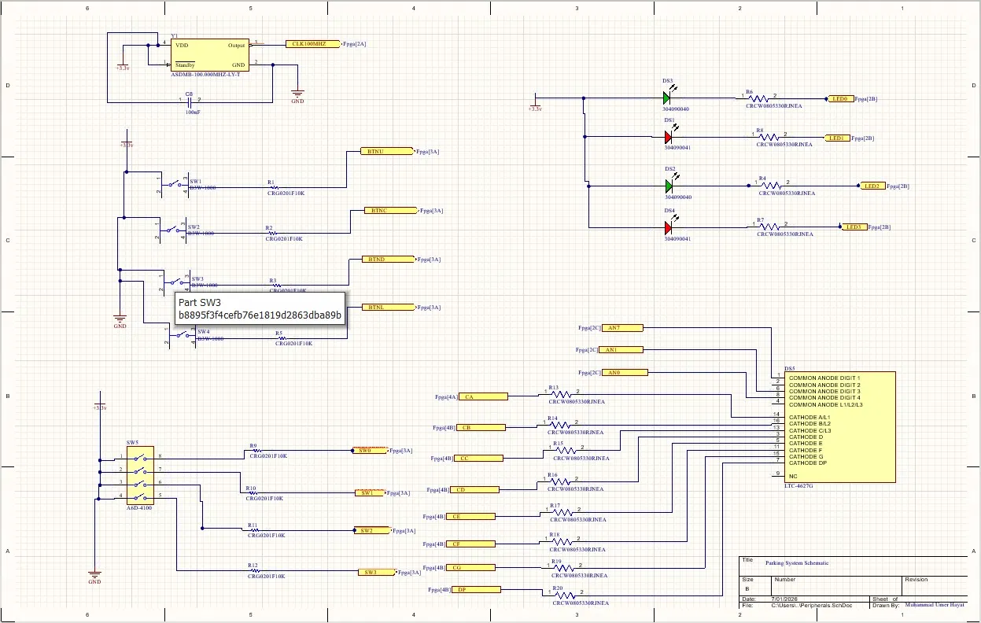
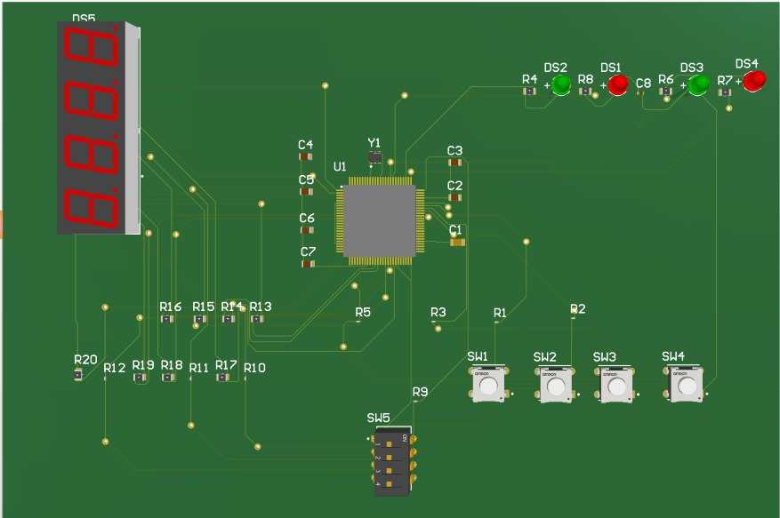
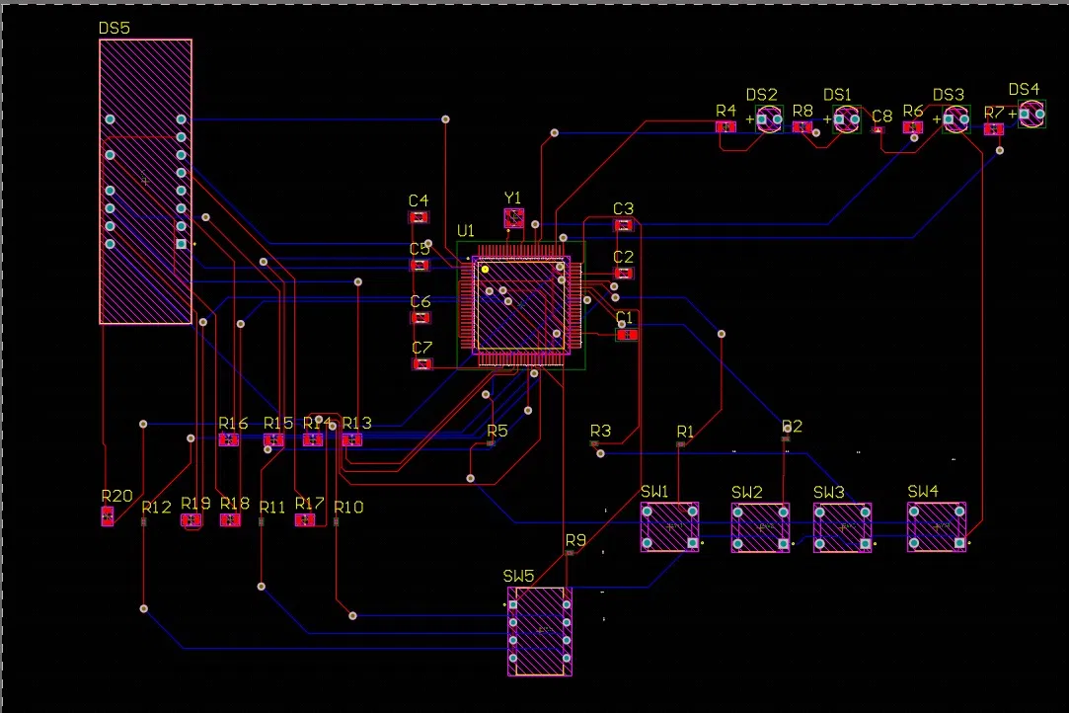
Full Schematic & PCB Design
Complete circuit schematic and routed board layout, designed in Altium Designer.
FPGA I/O Banks & Power Schematic
Parking System Schematic (Buttons, LEDs, Display)
PCB Design
Routed PCB - Altium Designer

